Slide 1
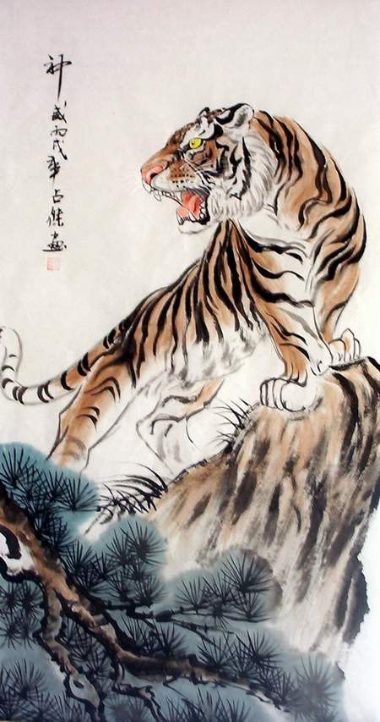
The Jungle Game
Chesshire Coders
Angélica Fallas
Adam Gundem
Alexander Hennings
Cameron Ackerman
Taner King
Image from: http://www.tattoodaze.com/tattoo-images/79/th_tiger-art-decor-mountain-tiger-tiger-hand-painting-original-bkLbwV.jpg

Slide 2
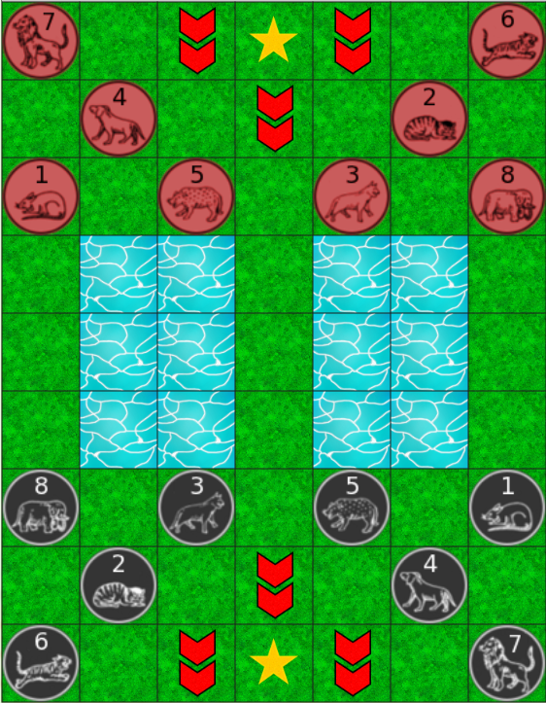












The Jungle Game
Jungle is a two-player strategy game.
Rat
Cat
Fox
Dog
Leopard
Tiger
Lion
Elephant
Normal
Den
River
Trap

Slide 3
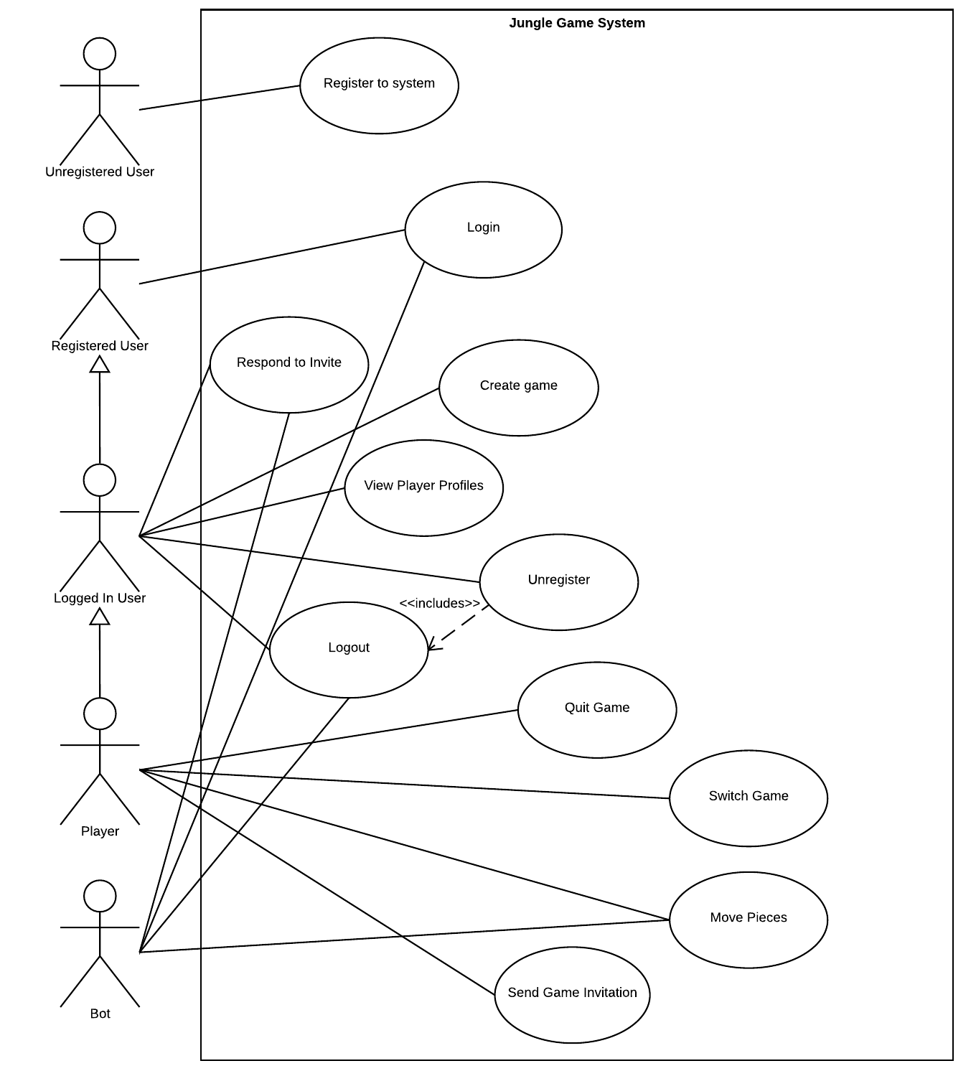
Use Case
Diagram

Slide 4
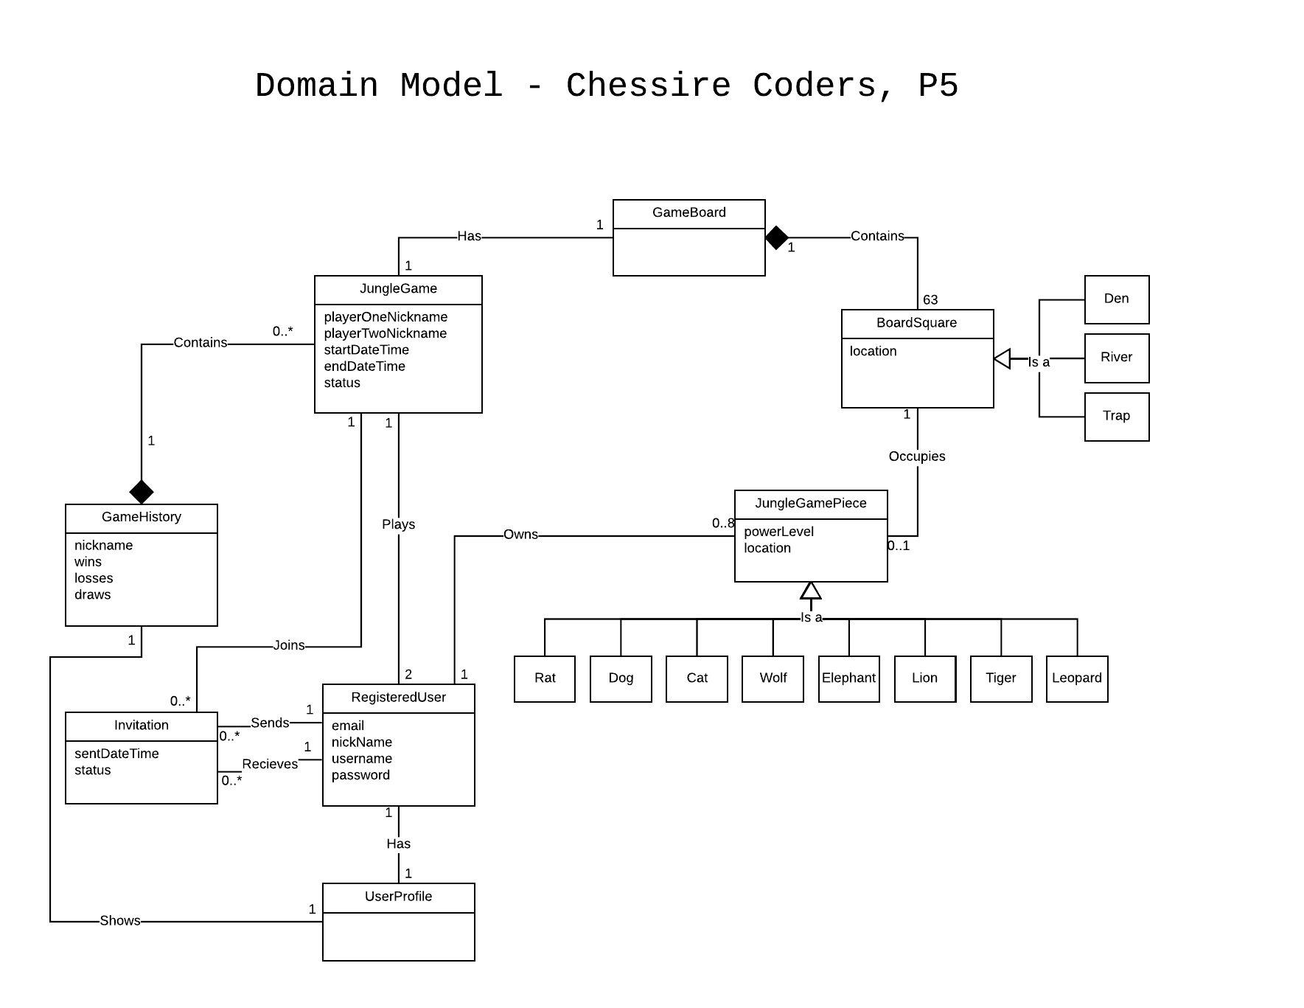
Domain
Model

Slide 5
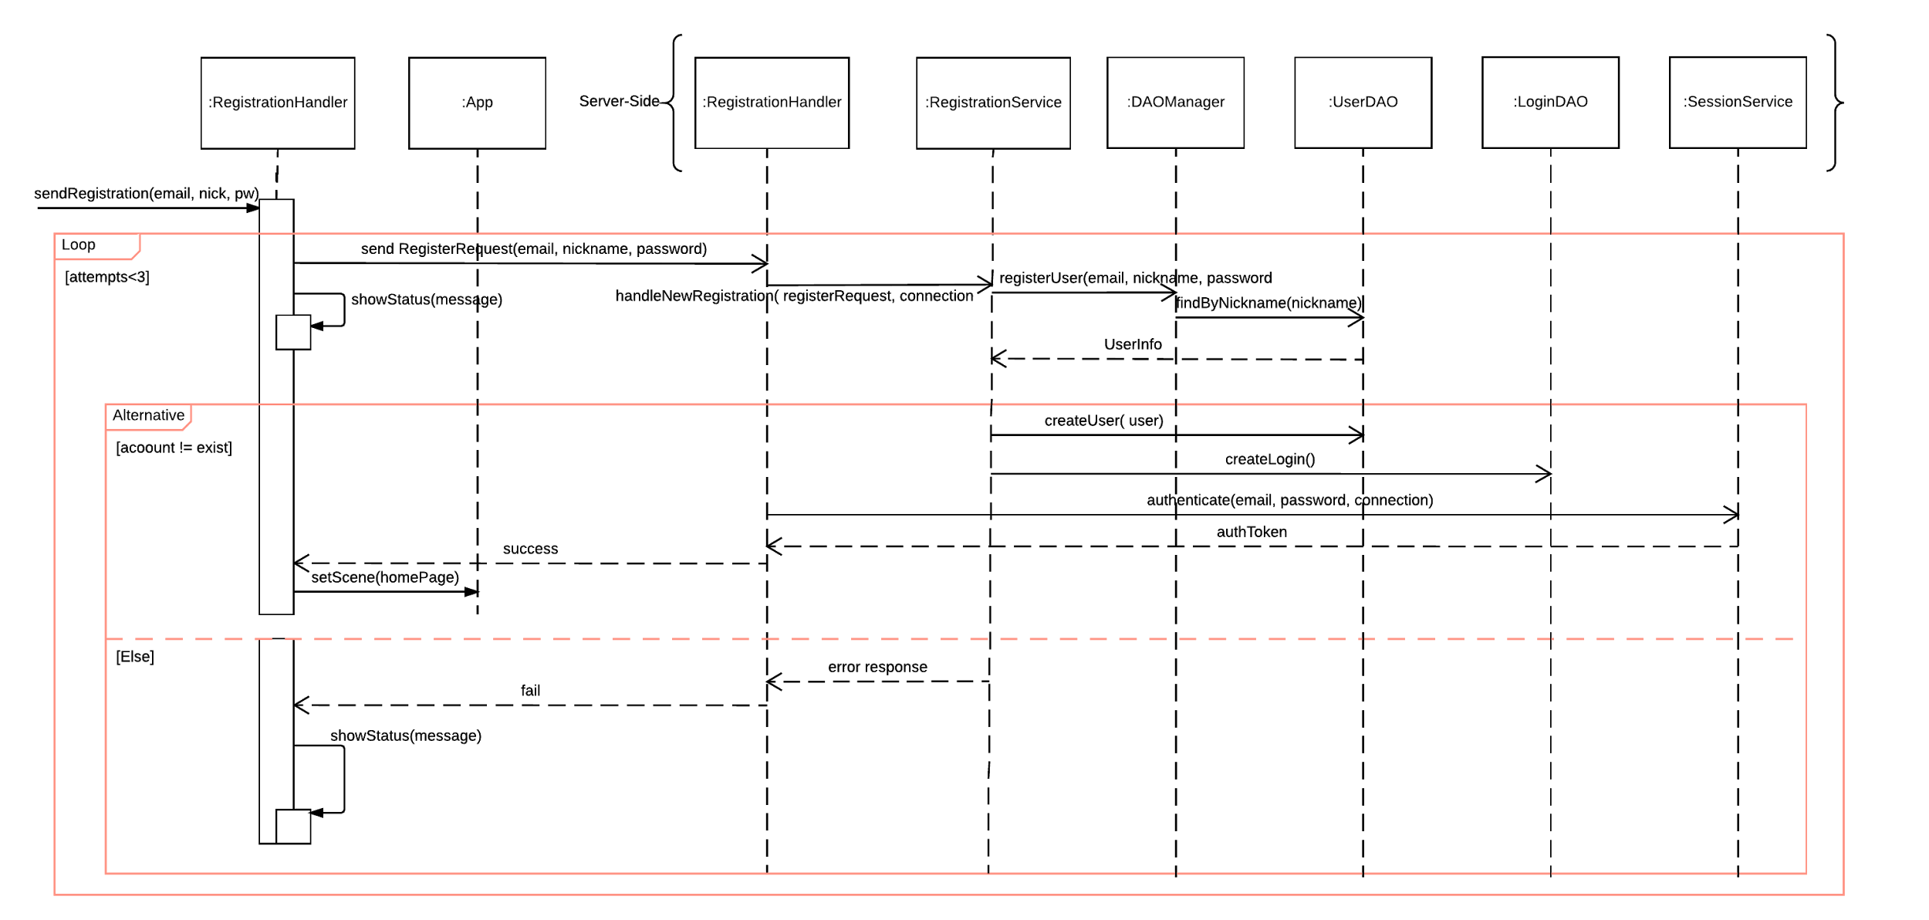
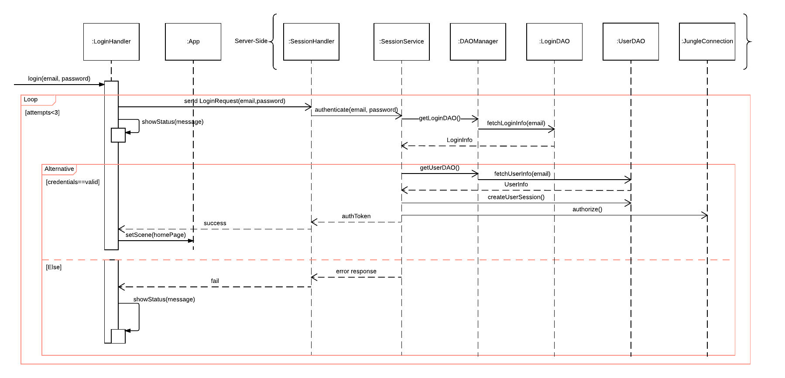
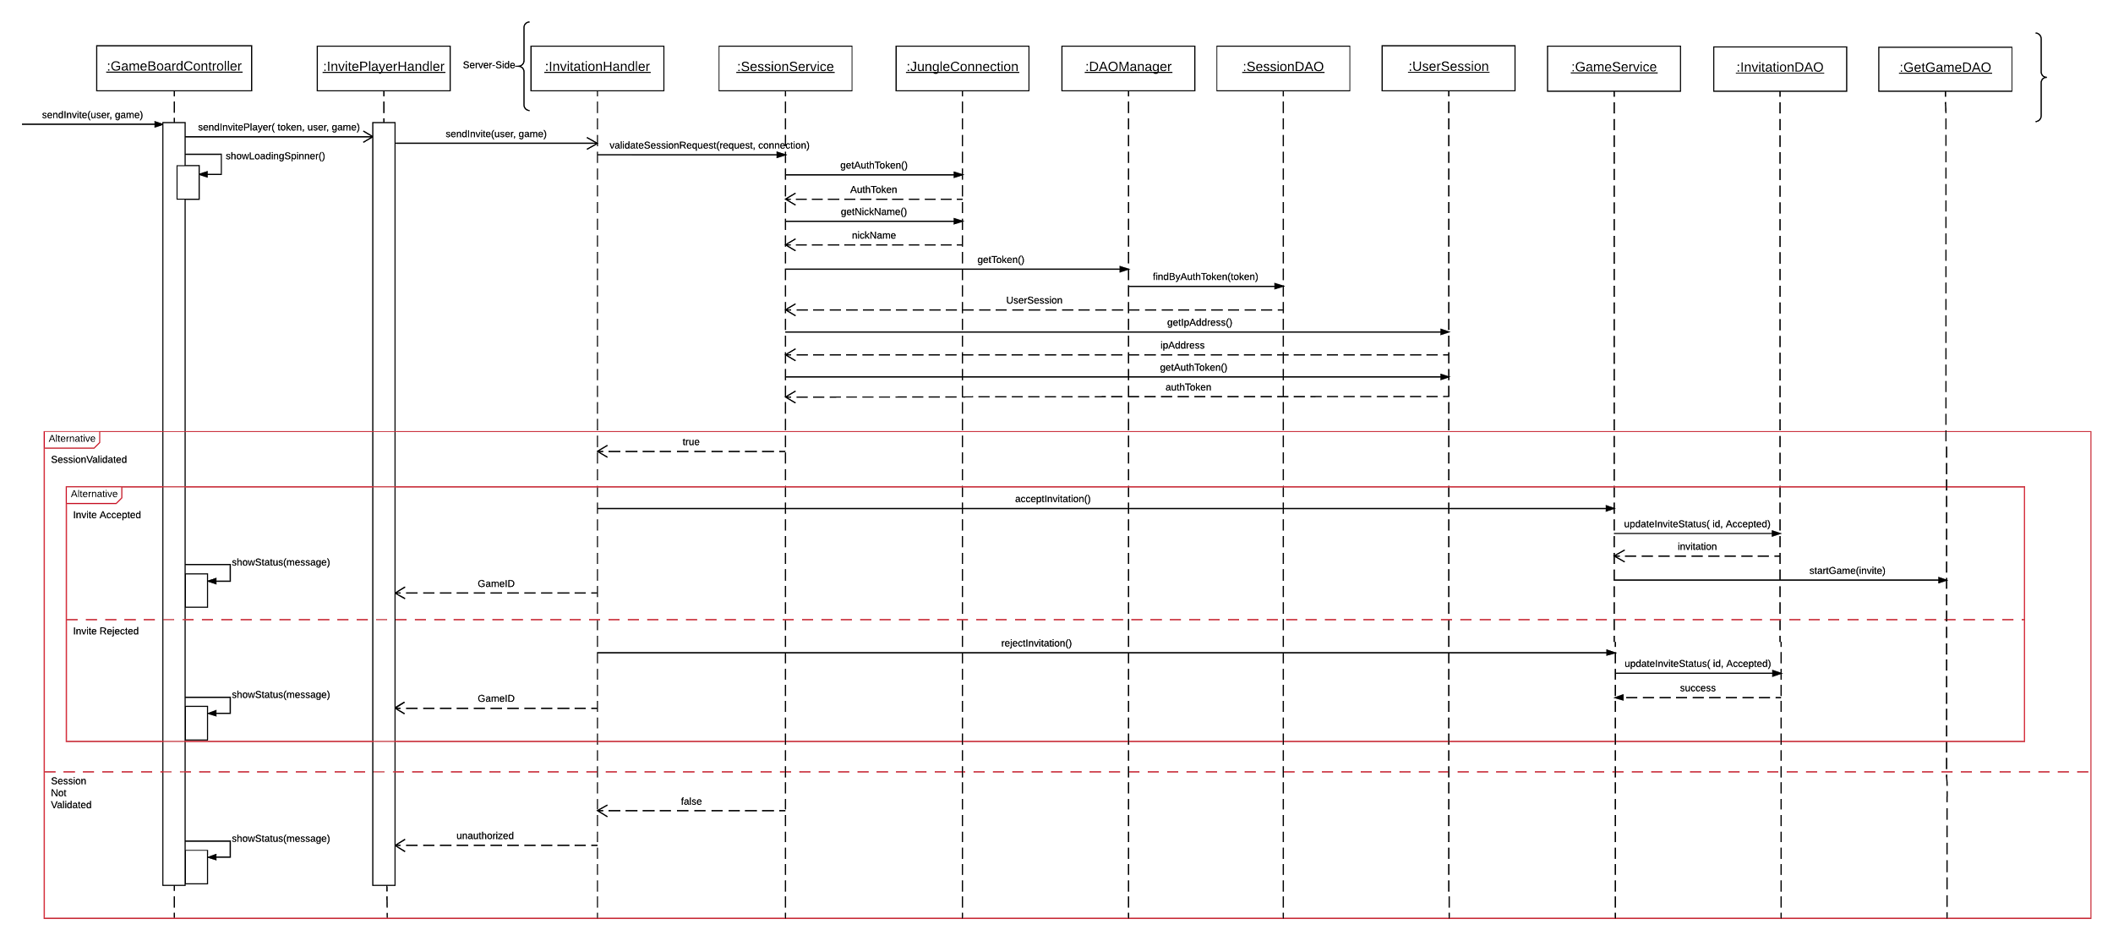
Sequence Diagrams
Register
Game Invite
Login

Slide 6
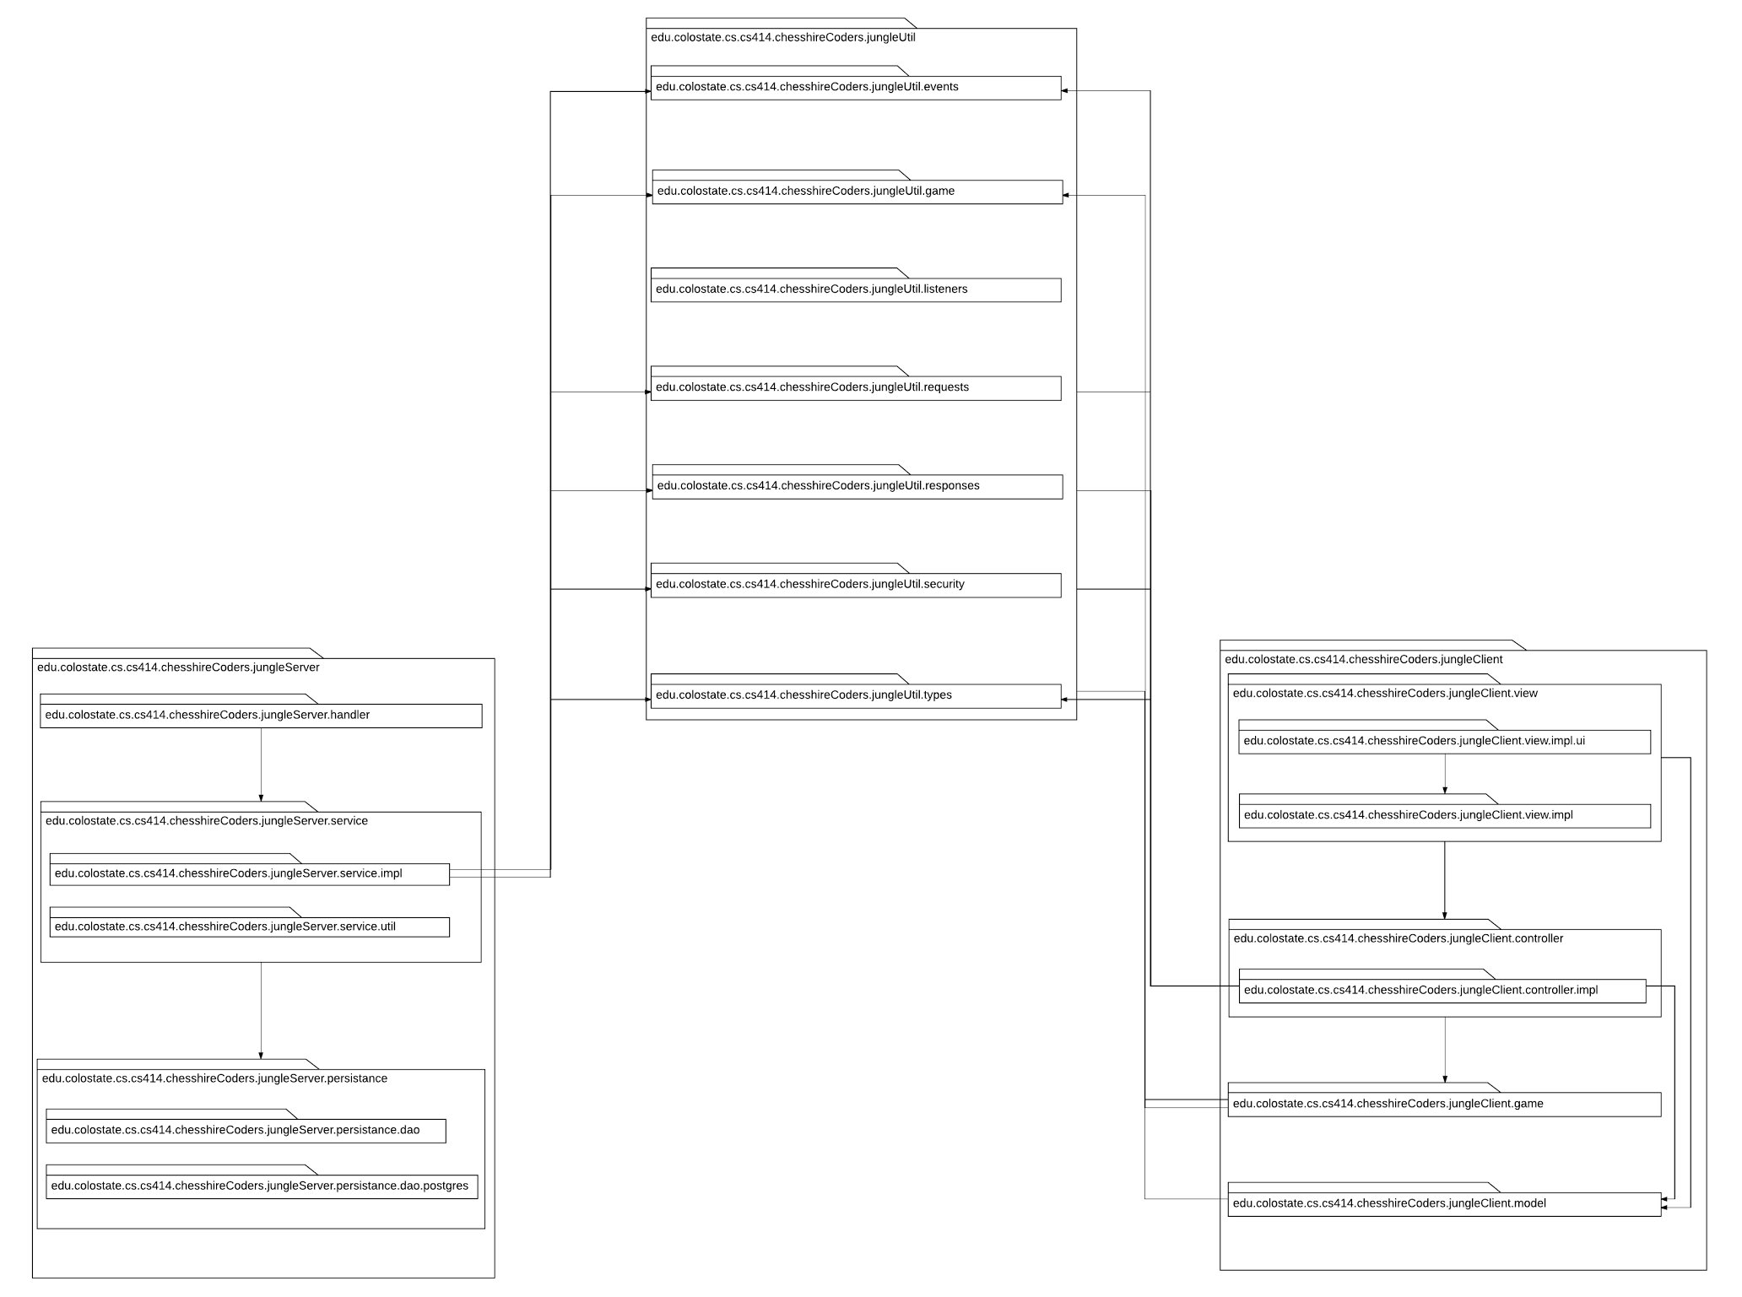
Package Diagram

Slide 7
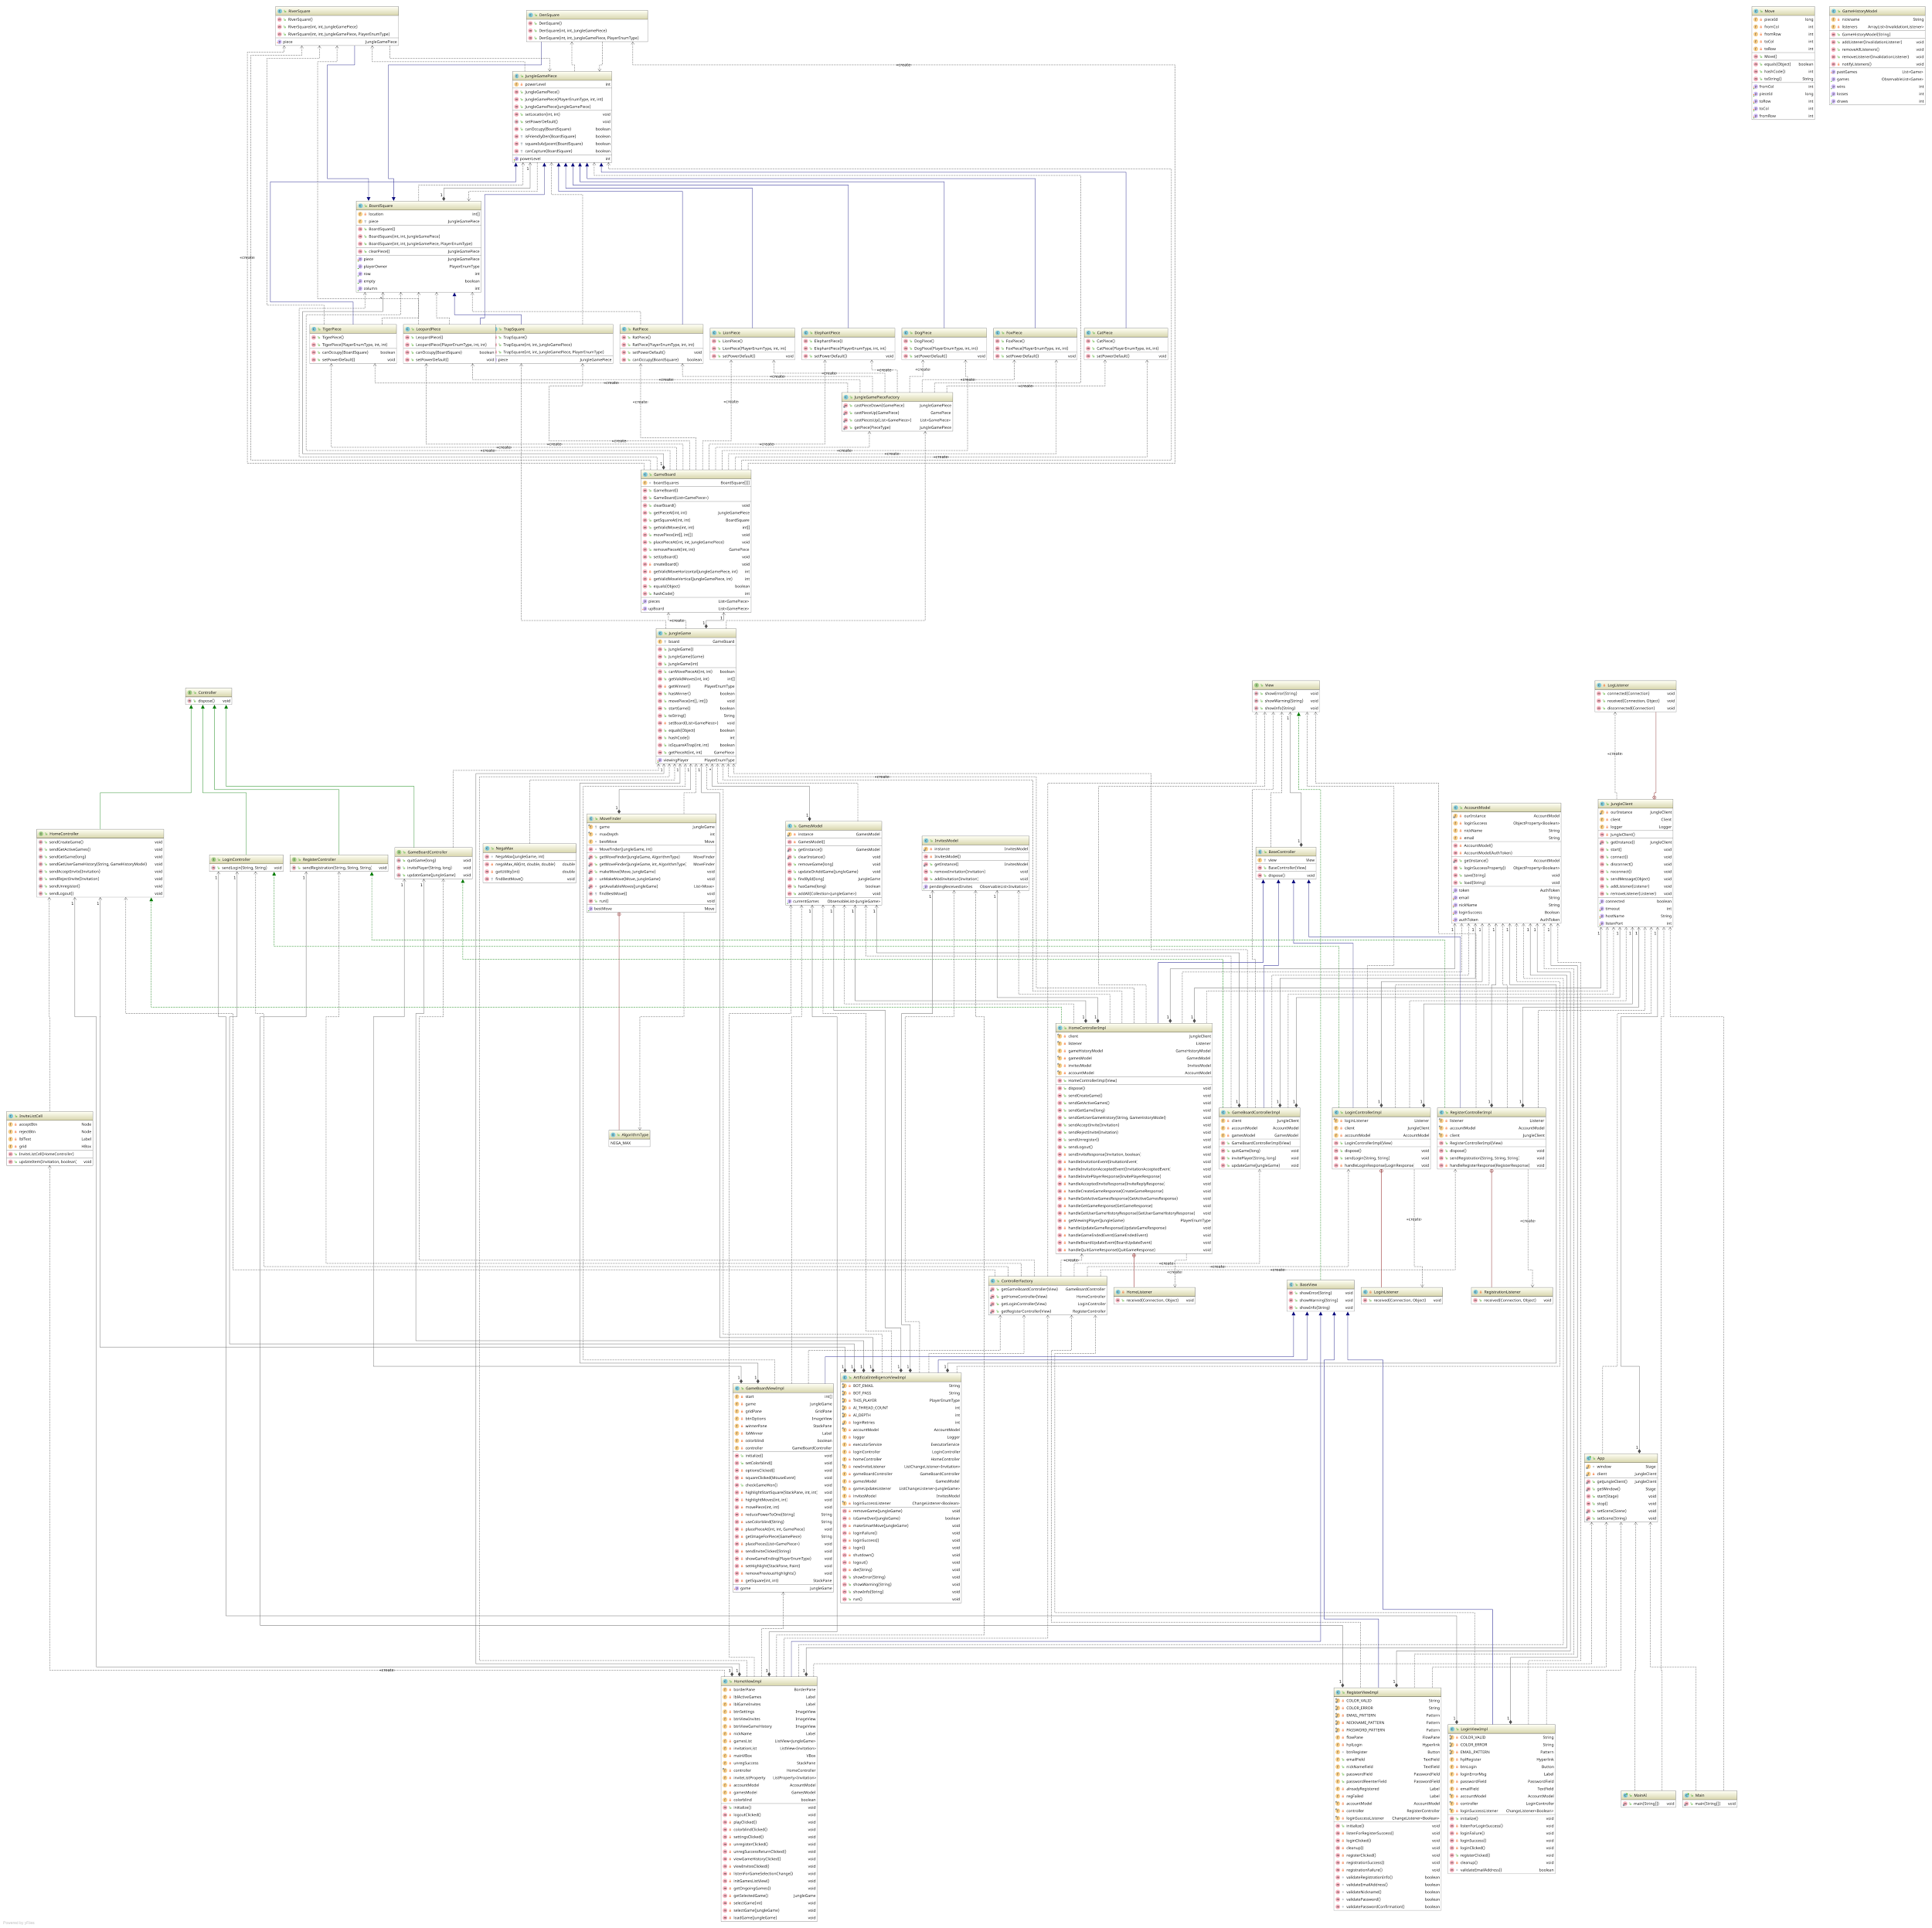
Class Diagram
- Client

Slide 8
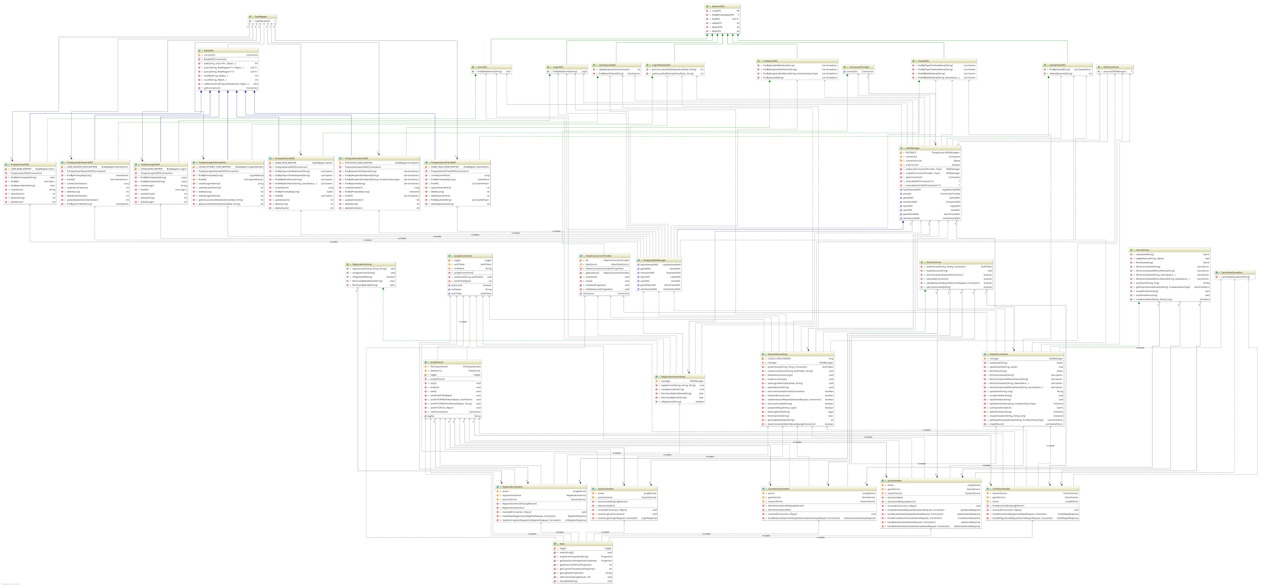
Class Diagram
- Server

Slide 9
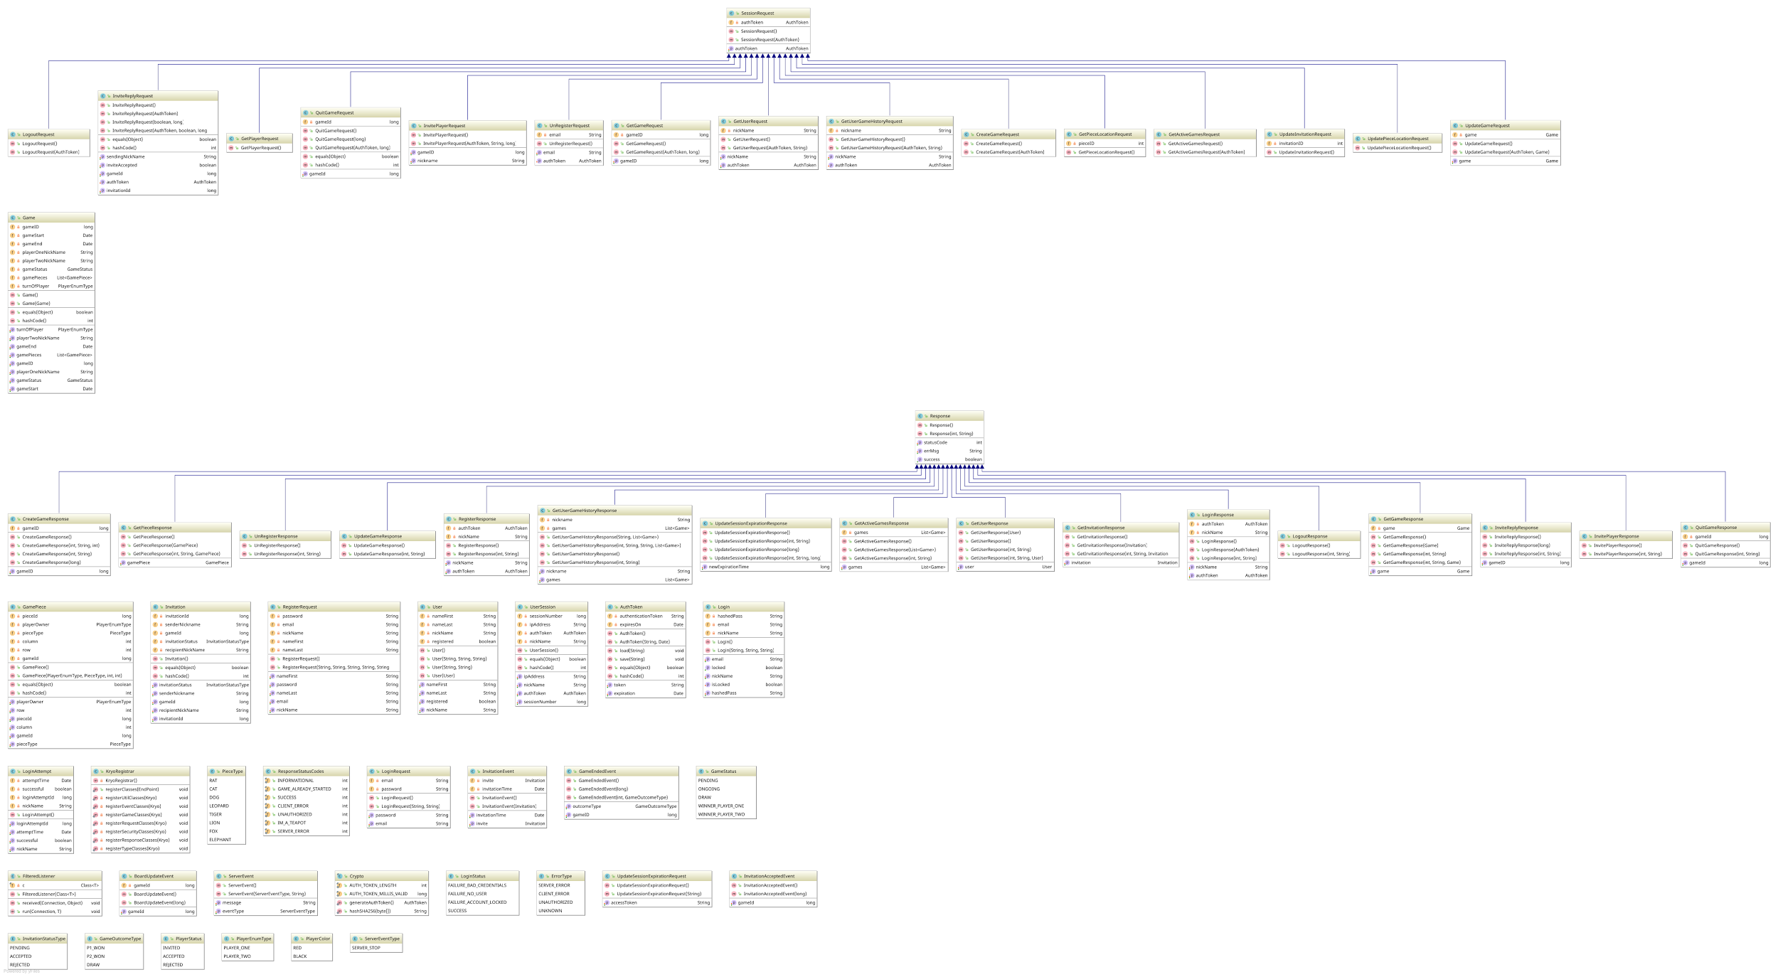
Class Diagram - Util.

Slide 10
Testing
Over 40 unique tests for Client side.
Over 25 unique, comprehensive Server side acceptance tests.

Slide 11
Development Manual Changes
Now uses GitHub’s Wiki.
Added IDE specific instructions.
Eclipse
IntelliJ IDEA
Added instructions for setting up database.
Using Docker + PostgreSQL
Using H2
Added instructions for setting run configurations for all applications.

Slide 12
Refactoring & Design Patterns
Refactoring:
Implemented MVC pattern in client
Method and class extraction
Existing Design Patterns
Singleton
Factory Method
Abstract Factory Method
Prototype
Facade
Decorator
New Design Patterns:
Observer
Factory/Abstract Factory
Model-View-Controller

Slide 13
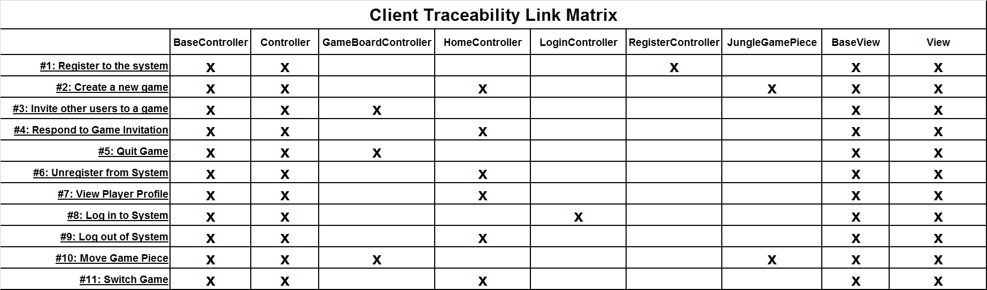
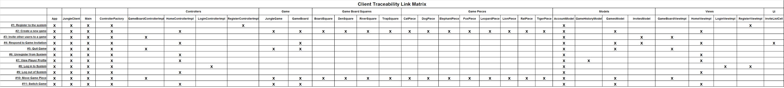
Client Traceability
Link Matrix
Server Traceability Link Matrix
Utility Traceability Link Matrix

Slide 14
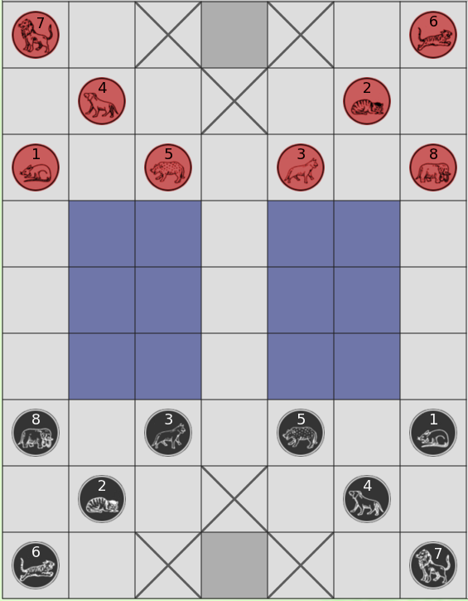
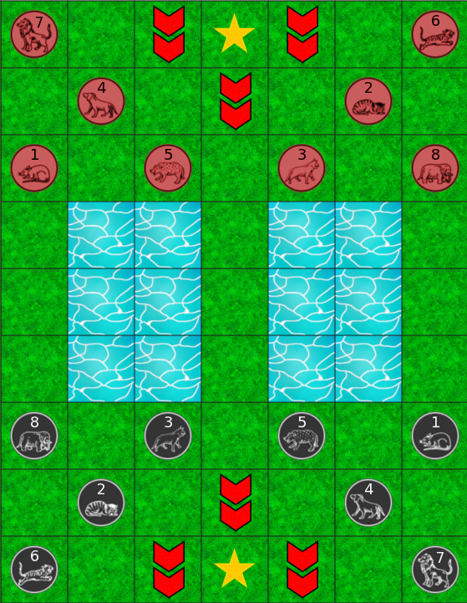
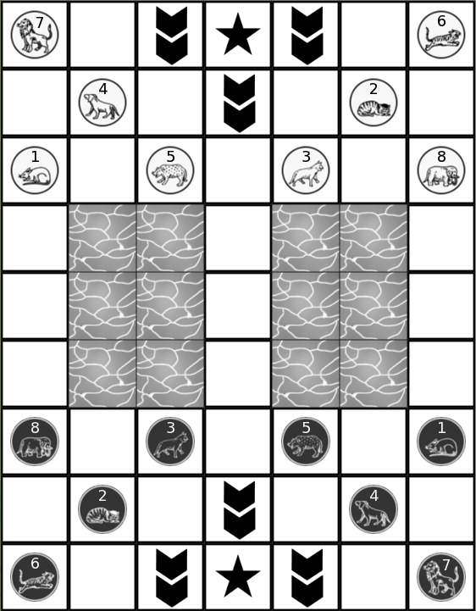
Old Art
New Art

Slide 15
Challenges & Lessons Learned
Challenges:
Using TDD.
Automated Testing.
Figuring out time and workload on github issues.
Managing structure and operation on github branches.
Constructing AI
Clear communication across the three core sections to our code. (Client, Server, and UI)
Lessons Learned:
Overlapping knowledge of the program code is critical to handling complications.
An overall focus is more beneficial than working individually.
Different perspectives and ideas improve the product when the main focus is maintained.
Good design is critical too much quickly leads to complication.
Wisely using your tools is helpful to manage shared knowledge.

Slide 16
Demonstration

Slide 17
Questions
And
Discussion

